Slide 1
Challenges in the geospatial sector:
A reflection
Nicholas Chrisman
Geospatial Sciences, School of Mathematical and Geospatial Sciences
RMIT University
Melbourne, Australia

Slide 2
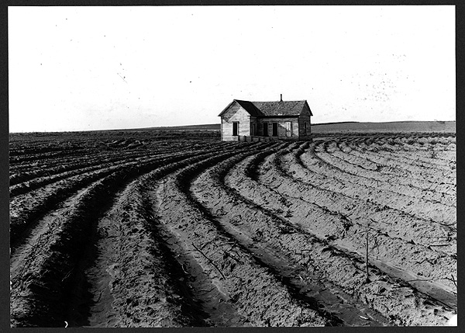
What are the challenges?
Maybe the things we left undone…
Notes:
Back some fundamental questions; missed opportunities, a chance to reconsider

Slide 3
A moment to reflect
Pathways of science and technology
  Historical situatedness
  Missed opportunities
  New openings

Slide 4
Today: 4 themes
Under the banner of Challenges
Big data? (Moore’s Law, AGILE 2012)
Even bigger: sensors (GEOIDE 2012)
Calculating on a round Earth (ISSDQ, 2014)
Information (Poore and Chrisman, 2006)

Slide 5
An open secret:
The power of GIS:
Integration of heterogeneous information
The threat of GIS:
Integration of heterogeneous information
Notes:
Le bon et le mal dérive des mêmes origines.

Slide 6
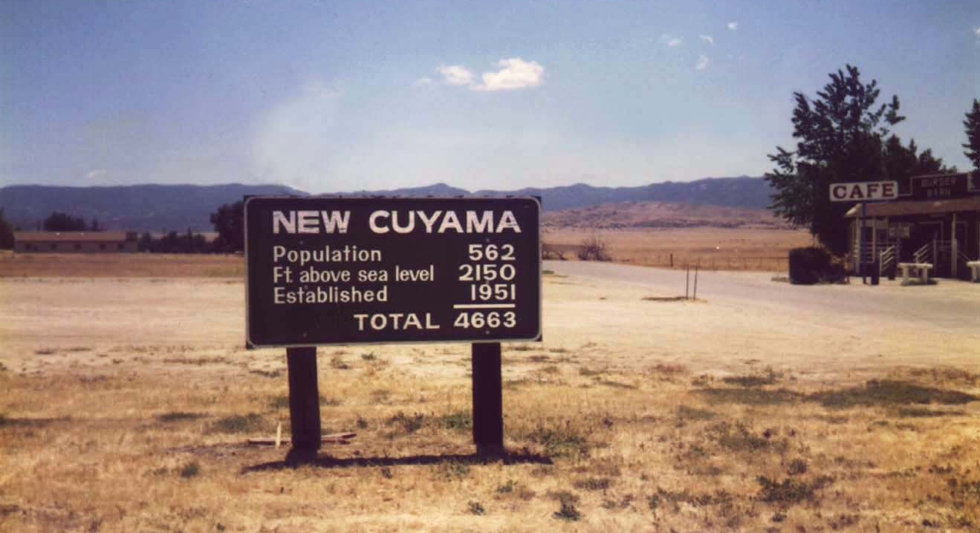
Everything is going to get:
Smaller
Faster
Greater capacity
More integrated
…
But, will this marvelous new world be any smarter?
Will we be stuck with the same old designs developed for a different set of conditions?

Slide 7
At the entry to New Cuyama, California
Integration at its most basic?
At least they know it is a joke.

Slide 8
Big Data?
At AGILE 2012, Jean-Philippe LAGRANGE (then at IGN France) set out the dilemma of an organization flooded with data.
Years prior to 2007: 50 Tb total
Now 100 Tb / year and increasing…
I am suspicious; demand out of balance.

Slide 9
Geospatial Sector
has always had BIG DATA.
  Now we can add real-time streams
  LiDAR point clouds
  And more…
Beware the urge of the moment

Slide 10
Economic bubbles
Public enthusiasm (and greed) take charge
  1637: Tulipomania (Netherlands)
  1720: Compagnie perpetuelle des Indes (France)
  1720: South Seas Bubble (England)
  And more recently…

Slide 11
Has Moore’s Law been protecting us from our lack of innovation?
Paper presented at AGILE 2012; Avignon, France

Slide 12
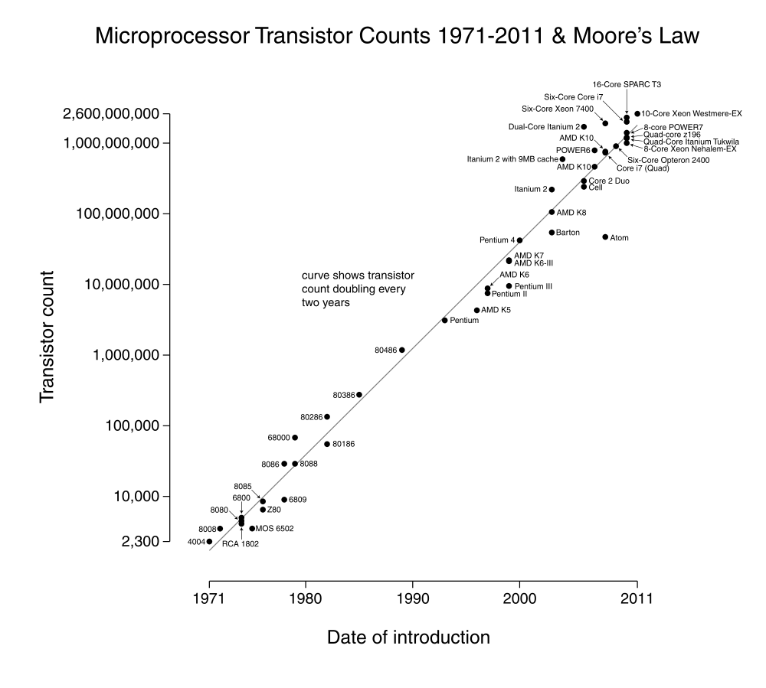
Moore’s Law
Gordon Moore (Fairchild Semiconductors)
1965: density of transitors doubles in 2 years
Converted to chip power doubles in 18 months
Or something like that…

Slide 13
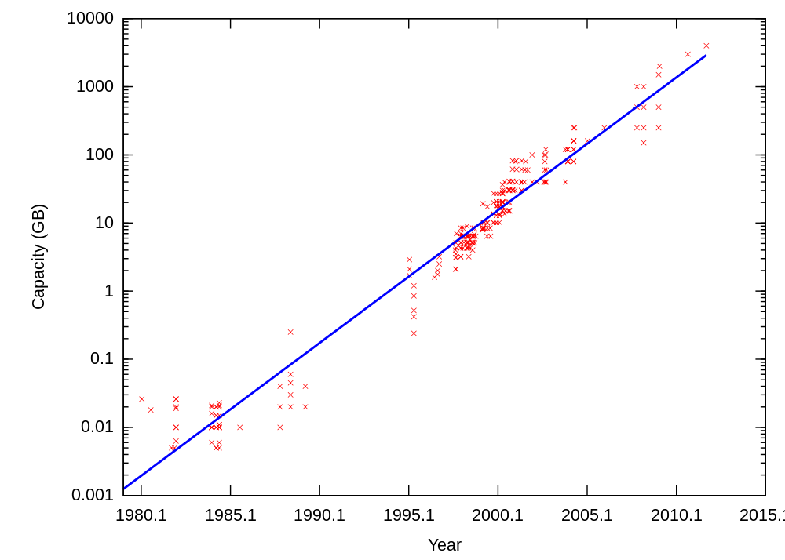
Applies to other computer technologies
Here, disk drives
Also memories,
USB sticks, etc.
Notes:
A lot more spreaqd, but a clear trend. This is based on retail advertisements, so not as directly linked to date of new production.

Slide 14
The Great Moore’s Law Compensator (TGMLC)
“Software is getting slower more rapidly than hardware becomes faster” (Wirth 1995)
Other versions attributed with ironic reference to various devils (Bill Gates, etc.)

Slide 15
Consequences for Geographic Information Science
Databases expand to fill the available space
Operating systems and user interfaces consume more and more cycles
Overall laziness propped up by expanding power and capacities

Slide 16
Inability to choose
For now, we are storing everything.
Delaying the moment when we will have to return to the old rules of selection, compilation;
Hard truth that information has to be extracted, reducing the data

Slide 17
Reduced attention to algorithmic complexity
Another consequence:
  Living with solutions that ‘worked’ on small datasets;
  Porting old software because it exists;
  Rereading the whole file to redraw because a spatial index is too much trouble;
  Applying brute force because the interface is easy to write…

Slide 18
Quick reminder
For example polygon overlay:
  (from 1992 SDH paper: base case 3000 X 3000 polygons)
 | Base case (Wisconsin) | Reduction factor | Times 1000
Brute Force (N squared) | 900,000,000 | -- | X 1,000,000
Band sweep | 19,000,000 | 1/47 | X 30,000
Band sweep with spatial index | 2,000,000 Intersection checks | 1/450 | X 2000
Notes:
Time 1000 to match J-Philippe’s millions of objects.

Slide 19
Persistence
Early software for least-cost surfaces (eg. MAP Package) used Dykstra’s algorithm (1959)
Code persists, even though alternatives are well-known (eg. Freedman and Tarjan, 1984)

Slide 20
Reducing complexity
Randolph Franklin and team (Brazilians) address pit-filling (topographic preprocessing for flow direction)
Huge reductions (near linear performance with larger grids; a few percent of current industry standards)

Slide 21
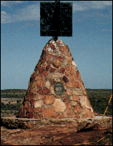
Solving truly big problems
Survey adjustments
  Gigantic matrices with constraints
    Dynamic Datums
    No fixed points
Now possible to perform simultaneous adjustments for whole geodetic network
  Even with cadastre (NZ)

Slide 22
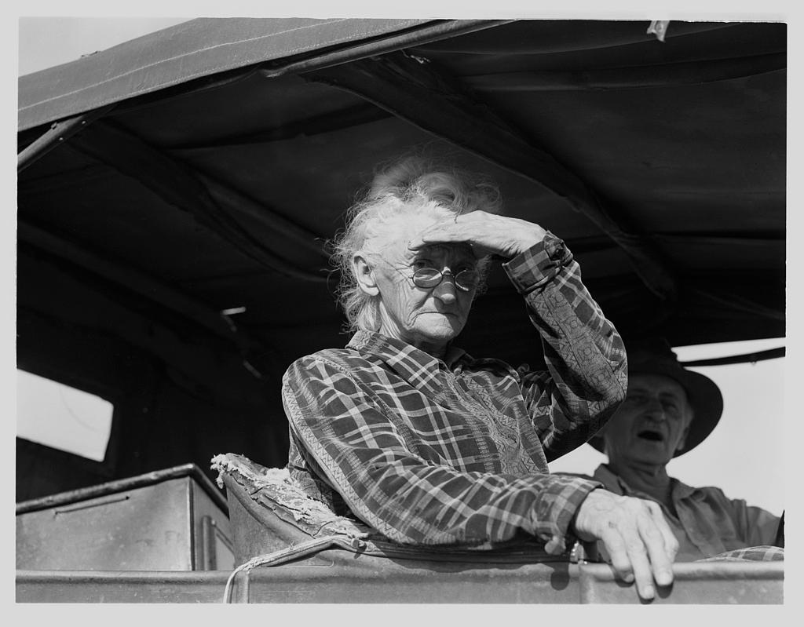
Even bigger: sensors
Theme 2

Slide 23
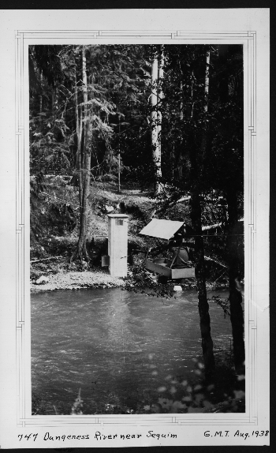
A river gage:
12048000 Dungeness River near Sequim WA
Location: Fixed
Time: Controlled
Height (of water): Measured
But how does the roll of paper get from the gage into use as a measurement?
Missing components: the guy with a pickup truck, and the digitizer- many steps…
Photo courtesy US Geological Survey
Notes:
As installed in 1938, swanky modern technology

Slide 24
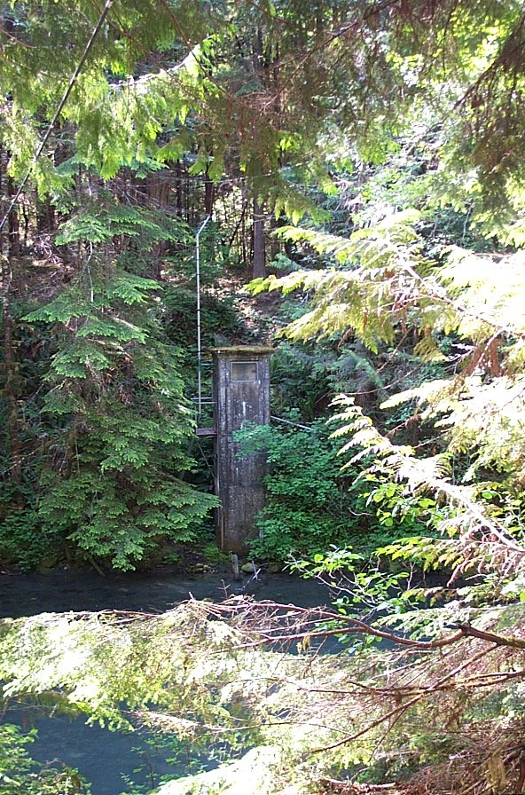
Advances in measurement
Astounding increase
    In spatial accuracy
    In speed of measurement
    In smaller sensors – everywhere
    In networks to connect sensors
The « flood » of data from the sky has not overwhelmed our processing capacity.
Too much effort expended in replicating the old ways of seeing the world.
Notes:
As it looked 70 years later, a forgotten piece of rusting equipment?

Slide 25

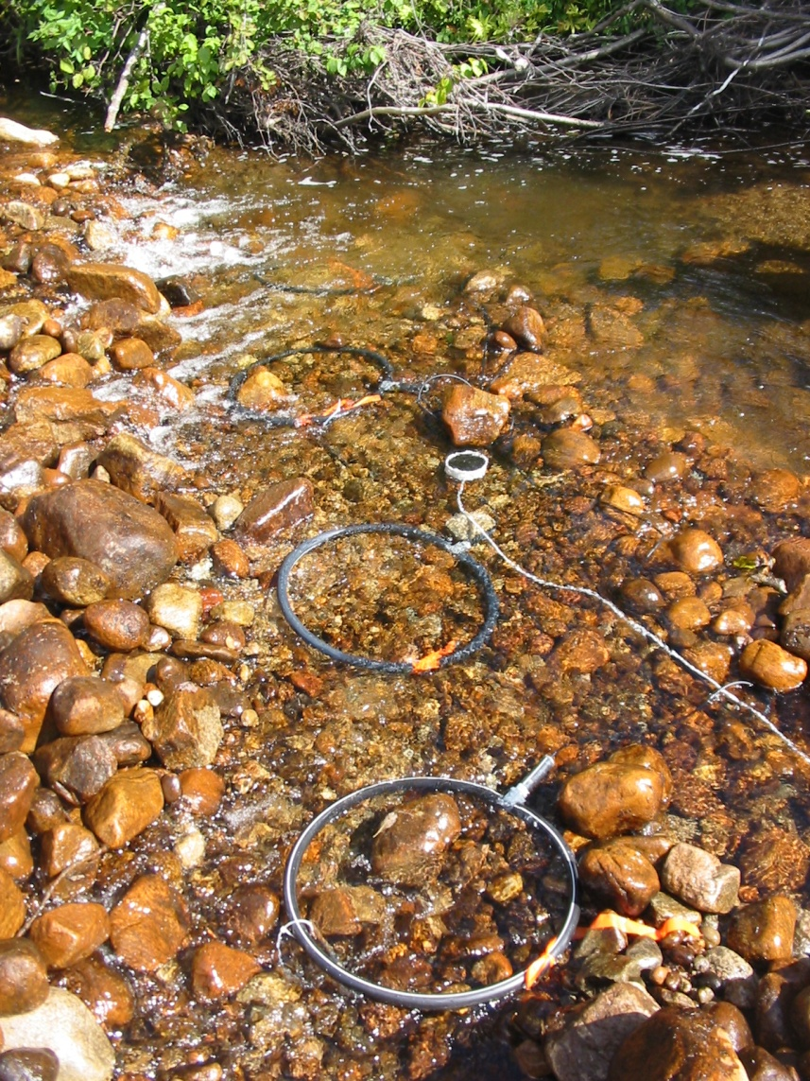
Sensors everywhere
Example from GEOIDE project
PIT-tag inserted inside salmon juvenile (passive)
Antenna array (active) placed under the stream bed

Slide 26
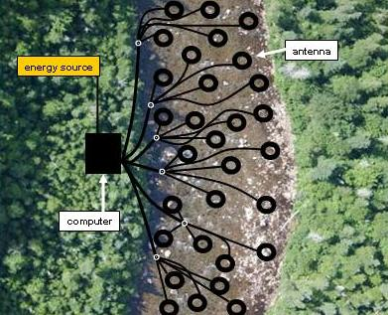
Results: a sensor network opens new science
256 antennas
one computer
energy from solar panels
network connection
As each fish swims over an antenna, its identity is recorded (in time and space).
Researchers have been able to observe new behavior –
beyond ‘stay’ and ‘leave’ : « commuters »
violates expected « minimum effort » models

Slide 27
Distributed Sensor Networks- a potentially disruptive technology
Original GIS process:
  First, collect the data (centrally)…
  Then, work to extract the value
With sensor web:
  Send query to autonomous sensors
  Answers calculated by network…

Slide 28
What is so disruptive?
Sensor webs decentralize
It becomes impossible to start by collecting « all » the data…
Collaboration between collectors becomes central.
Raises issue of what information will be useful (to whom and when…)

Slide 29
Lessons?
Is the technology really the issue?
Is it important to use resources sparingly (intelligently)?
Is calculation essentially ‘free’?

Slide 30
Useful glimmers
Big Data movement not entirely misdirected;
Great potential in making unsuspected conections
Great potential in engaging greater participation (crowd sources enlarge the community)

Slide 31

Theme 3
It is round…

Slide 32
FIRST, DO NO HARM: Eliminating Systematic Error
In Analytical Results Of GIS Applications
Nicholas Chrisman
RMIT University, Melbourne Australia
Jean-François Girres
Université Paris-Est

Slide 33
Precautionary principle
GIS practice should reduce errors when possible…

Slide 34
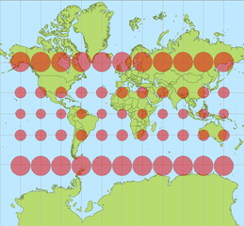
We all know that map projections distort
Source: Stefan Kuhn, http://commons.wikimedia.org/wiki/File:Tissot_mercator.png, Creative Common attribution license

Slide 35
Yet,
GIS applications typically convert to a projection
And never look back
Measures (perimeter and area) are not corrected.

Slide 36
Official coordinates
Almost universally based on conformal projections
  Preserve angles
  Make surveying calculations simpler
  And artillery simpler

Slide 37
Transverse Mercator
Various forms: UTM, MTM, Gauss Kruger, US state plane zones, etc.
Scale factors: 0.9996 UTM, 0.9999 MTM Canada, 1.0000 G-K Germany 0.9999995 Delaware
Source: Snyder 1989, p.50

Slide 38
Let’s rephrase it
Error factor = 1 – scale factor
  (factor for linear measurements)
  UTM: -0.0004 on the central meridian
    +0.0004 on edge of zone
    (that means 0.04% too long)
Not huge, but not insignificant…

Slide 39
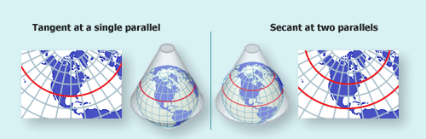
Lambert conformal conic
In many other jurisdictions
  With east-west zones
  Examples: France, Grille Lambert
  Washington (N & S), etc.

Slide 40
Zones
TM zones bands of longitude:
  UTM balances errors in a 6 degree zone
  MTM balances lower errors in 3 degree zone
  UK National Grid 8 degrees (but poleward)
Lambert zones bands of latitude:
  France: 2 degrees of latitude (1993)

Slide 41
Oblique stereographic
Every rule has an exception!
  Netherlands (with Poland, New Brunswick and Romania) uses Oblique Stereographic
Still a conformal projection
8 projections used across Europe
Only Portugal uses an equal area Bonne

Slide 42
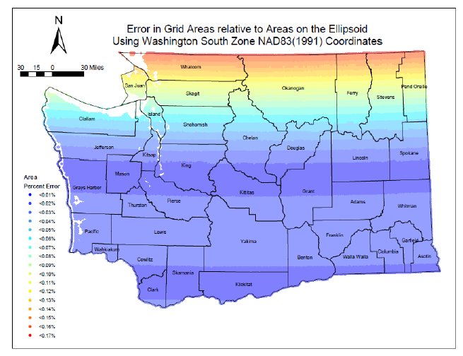
Extending zones increases error
Washington State: common practice uses South Zone for whole state
Consequence: error factor exceeds +0.0017

Slide 43
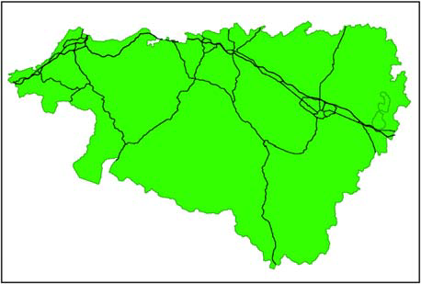
Real cases
Road network (Pyrenées Atlantique)
  Length overestimated by 0.05%
  (just south of standard parallel)

Slide 44
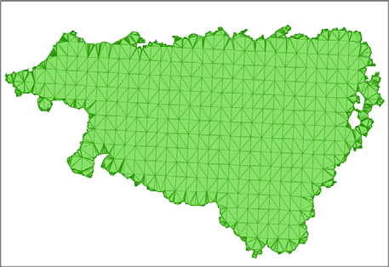
Area error
Area error is approximately double the linear error (for conformal projections)
eA = 2 * eL + eL²
Result (Pyrenées Atlantique) overestimated by 0.12%; ground truth estimated by ellispoidal triangles.

Slide 45
Policy consequences
Conversion to the new (lower error) projection for France
  reduced farm subsidy payments by 17 million euros
  due to more accurate estimates of area
  Source: Harmel (2012)

Slide 46
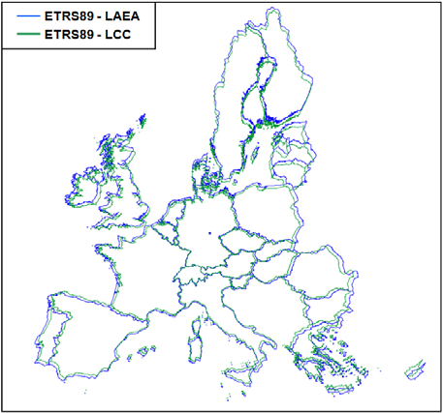
Solutions
GIS results could be rescaled based on a local scale error (depends on how large the object, may vary)
Stop using conformal projections for area estimates (eg EU offical projection)
More radical?

Slide 47
Lessons
GIS professionals have a duty to remove known errors and biases from reported results.
Projection error is totally foreseeable and mathematically known.
Small effects can have substantial consequences.
Notes:
Work in progress

Slide 48
Acknowledgements
Research support
  IGN France, RMIT
Assistance: John Snyder, Rod Deakin and other projection specialists

Slide 49
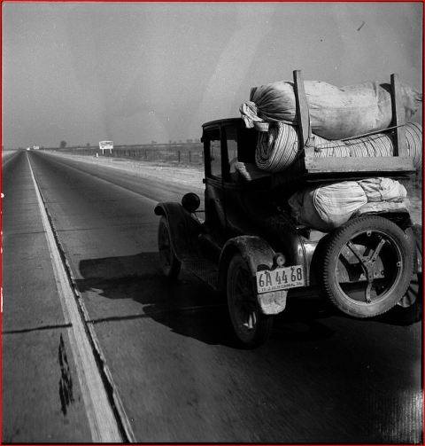
Time to reduce the baggage
Theme 4

Slide 50
comes down to information

Slide 51
Disruption at the conceptual level
The idea of centralized knowledge
  European Enlightenment:
    e.g. Diderot: Encyclopédie universelle…
    Bruno Latour: centres de calcul (LaPerouse)
This idea keeps coming back
  actually behind the World Wide Web
  but the WWW ends up disrupting itself…

Slide 52
The I in GIS
The middle word:
Not the one argued over…
Yet crucial.
Notes:
Information

Slide 53
Extract from a paper
(Annals AAG, 2006):
Order from Noise:
Towards a social theory of information
Barbara Poore, US Geological Survey
Nick Chrisman, GEOIDE

Slide 54
Two conflicting models of information
Both arise from Cybernetics movement in late 1940s
Shannon [Bell Labs] (publicized by Weaver)
    Transmission model: encoding as bits
Norbert Weiner [MIT, Lincoln Labs]
    Control of aircraft gunnery, cybernetics
    Feedback as main issue

Slide 55
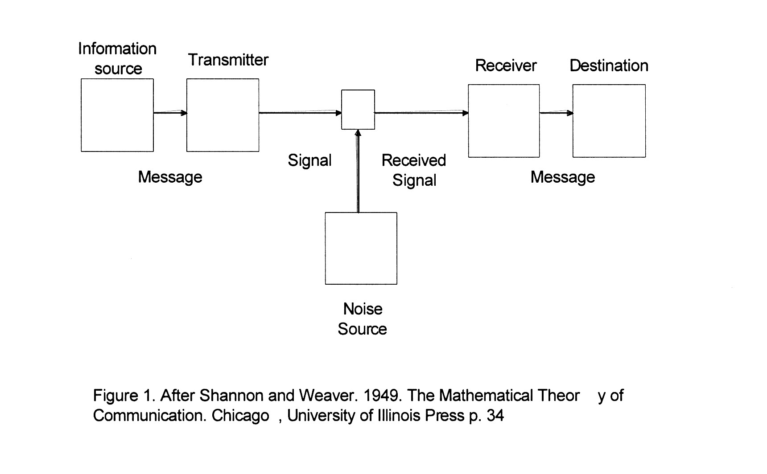
Shannon’s boxes and arrows
Invariance through transmission;
Meaning not a part of model

Slide 56
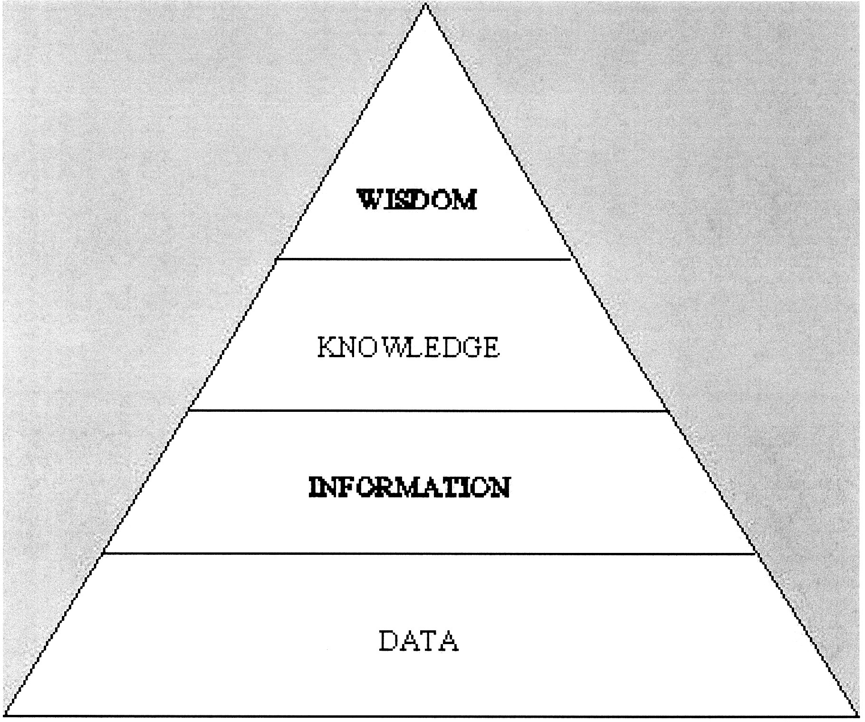
Model of refinement
Weiner promotes the mythology

Slide 57
An alternative:
Social definition of information
Goguen: an interpretation of a configuration of signs for which some social group is accountable.
“a difference that makes a difference”
Notes:
About the catchy phrase, couldn’t locate it… Had to remove it from the book…

Slide 58
So, here is the citation:
Bateson, Gregory (1972). Steps to an Ecology of Mind: Collected Essays in Anthropology, Psychiatry, Evolution, and Epistemology. University Of Chicago Press. ISBN 0-226-03905-6
And some context:
Gregory Bateson, a psychologist, married Margaret Mead.
  Participated with Shannon, Weaver, von Neumann, Weiner, and other in the Macy Conferences (1940s-50s) – which defined « cybernetics » and modern information theory.
Count Korzybski (« The map is not the territory ») was not far away…
Notes:
Important moments: when multiple disciplines start sharing their ways of looking at the world. We have been stuck with the initial statements of the engineers who came to Macy, not the result of the discussion!

Slide 59
And a consequence (or two)
van Foerster: « you can turn a library upside down, but not a drop of information will flow out »
All writing requires an audience; meaning is interpreted by the reader
Notes:
The meaning was not in Shannon’s model, and it has to be considered.

Slide 60
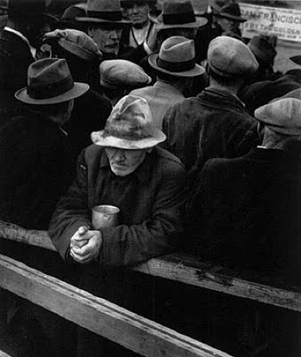
Let’s reconsider value
Comes from use
NOT inherent in the data
Information is about relationships…

Slide 61
Let’s relearn forgetting
Increase in storage delays the inevitable
Some day we will have to make choices
Deletion is required, even a good thing
Information is created by adding value, not saving everything.

Slide 62
Let’s get ready
For greater decentralization (sensors);
For greater diversity in sources
For more dynamic (real-time) applications
For changing the business model

Slide 63
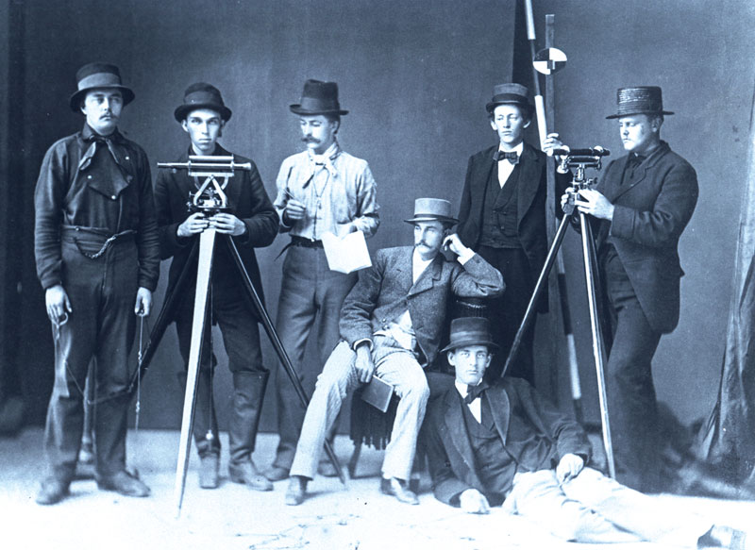
What can we do?
Notes:
Back to some basics?

Slide 64
A modest suggestion
To embrace the real, changing World, let’s stop calculating on projections
  Yes, I mean no UTM, Gauss-Kruger, Lambert zones, or whatever…
  One global system of coordinates on ellipsoid
  ITRF as reference frame (to handle dynamics)
Notes:
No need for scale factors, distortions of area, distance, angle…

Slide 65
Conclusion
Many challenges for the geospatial sector
  Strength will come from collaboration
  Solutions from unexpected sources
Don’t carve anything in stone – yet…
Notes:
Work in progress

Slide 66
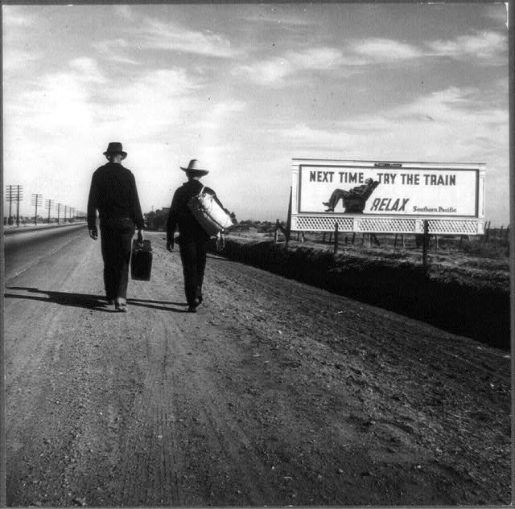
It’s a long process
Toward Los Angeles; Dorothea Lange, 1937

Slide 67
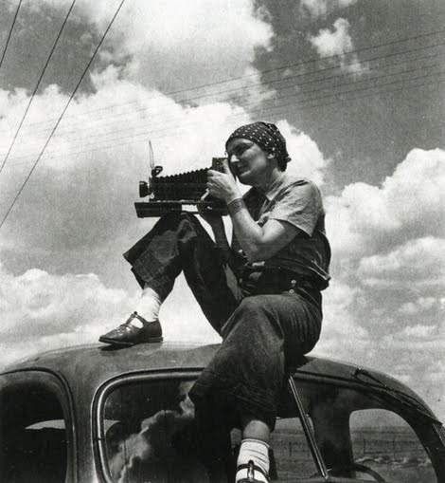
Acknowledgements
Research support
  Present: RMIT, Australia
  Past: SSHRC & GEOIDE, Canada
  Past: NSF, USA
Assistance: many students and colleagues
Photos: Dorothea Lange (FSA, 1937…)

