Slide 1

Tool for Assessing Statistical Capacity (TASC)
The development of TASC was sponsored by the United States Agency for International Development

Slide 2
Outline
About the TASC
Format
A Look at the TASC
Filling out the TASC
Modules

Slide 3
About the TASC
The Tool for Assessing Statistical Capacity
(TASC) was developed by the U.S. Census
Bureau with the support of the U.S. Agency
for International Development (USAID).

Slide 4
About the TASC
Identifying areas of strength and weakness in the preparedness of an National Statistical Office (NSO) to conduct a census or survey is difficult and subjective.
The TASC addresses this by providing quantitative measures of the capacity of an NSO to conduct a census or survey.

Slide 5
What is statistical capacity?
Statistical capacity is a nation’s ability to collect, analyze, and disseminate high-quality data about its population and economy
-as defined by The World Bank
http://datatopics.worldbank.org/statisticalcapacity/

Slide 6
About the TASC
Results from the TASC can be used by NSOs and
their stakeholders to:
Provide a measurable score for statistical capacity, and
Identify specific areas where the NSO could benefit from further training.
The TASC can be conducted at two different points
in time to assess improvement or impact of an
assistance program.

Slide 7
Format – Operational Modules
The TASC has an operational module for each step of
a census or survey:
Planning and Management
Mapping
Sampling
Questionnaire Content and Testing
Field Operations
Data Processing
Data Analysis and Evaluation
Data Dissemination
Publicity

Slide 8
Format – Institutional Capacity
In addition to these operational modules, there
is an additional module that measures the
overall institutional capacity of an NSO.
The TASC was organized in this way to:
Facilitate administration
Clearly define the areas where the NSO rates high or low on statistical capacity

Slide 9
Format
Each of the operational modules is divided into
four subsections:
Human and physical capital
Methodological soundness and international standards
Quality assurance
Written procedures and documentation

Slide 10
Format
A mobile data capture score is provided. The mobile data capture score combines questions related to mobile data capture onto one sheet.
The mobile data capture score:
Is not based on a separate mobile data capture section
Reflects the cross-disciplinary skills necessary to implement a mobile data capture census or survey

Slide 11
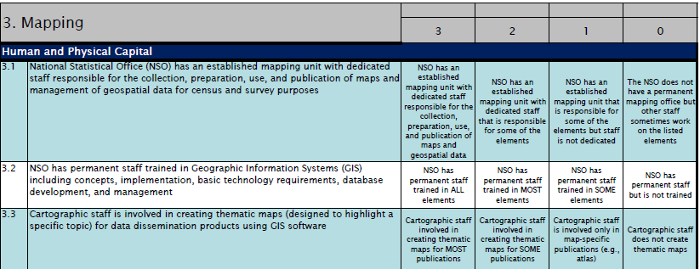
A Look at the TASC

Slide 12
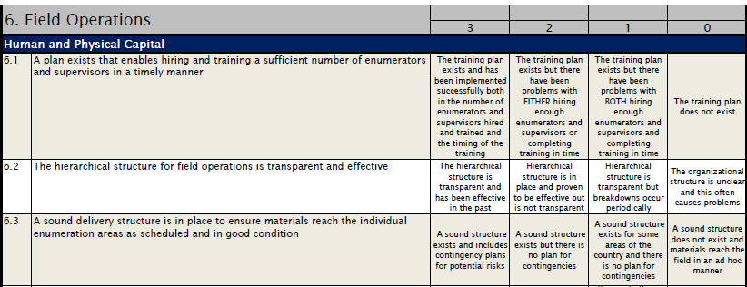
A Look at the TASC

Slide 13
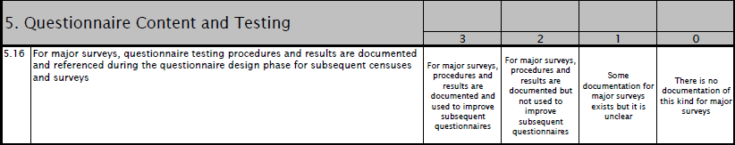
A Look at the TASC
Questions can be rated from 0 to 3, with:
3 = highest score
0 = lowest score
N/A = if the question does not apply to you

Slide 14
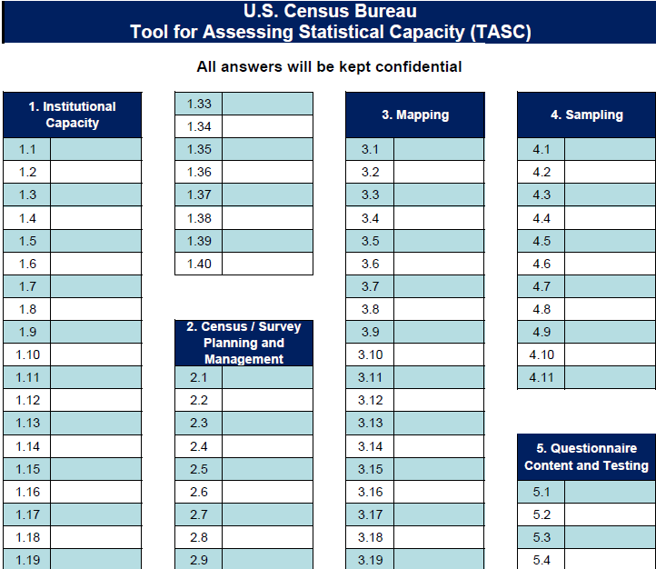
Filling out the TASC
You will receive an answer sheet. Please:
Read each statement carefully
Choose the most appropriate answer
Write that answer on the answer sheet

Slide 15
Filling out the TASC
The TASC is filled out in two stages:
Individually
As a group

Slide 16
Filling out the TASC
Remember that accurate answers will help:
Give your organization recognition where it is deserved
Identify areas for further training and technical assistance

Slide 17
Modules
As a reminder, the 10 modules of the TASC are:
Institutional Capacity
Planning and Managing
Mapping
Sampling
Questionnaire Content and Testing
Field Operations
Data Processing
Data Analysis and Evaluation
Data Dissemination
Publicity

Slide 18
Modules
The next few slides describe what aspects are measured in each module.
Please make a note of the specific modules that relate to your work experience and skills in this organization.

Slide 19
Modules
The Institutional Capacity module asks questions concerning:
The legal background for censuses and surveys
Data confidentiality practices
Organizational structure of the NSO
Human and physical capital of the NSO
Stakeholder coordination

Slide 20
Modules
The Institutional Capacity module should be completed by:
Census and Survey Managers
Managers of other areas involved in censuses and surveys (e.g. IT, field operations)

Slide 21
Modules
The Planning and Management module asks questions concerning:
Planning and management of staff, budget, and other resources
Other aspects of planning and management such as number of people trained or software used
Should be taken by: managers

Slide 22
Modules
The Mapping module asks questions concerning:
Skill level and software used by mapping personnel
Characteristics of the maps
Scope of the mapping program
Dissemination using maps
Should be taken by: mappers / cartographers

Slide 23
Modules
The Sampling module asks questions concerning:
Methods for sampling, data adjustments, calculating sampling error, etc.
Sampling frames
Should be taken by: statisticians

Slide 24
Modules
The Questionnaire Content and Testing module
asks questions concerning:
How questionnaire content is chosen and tested
Balancing international standards with historical continuity and local context
Should be taken by: subject matter specialists and
demographers

Slide 25
Modules
The Field Operations module asks questions
concerning:
Plan for hiring and training enumerators
Tracking forms in the field
Pilot testing
Enumerator manuals
Should be taken by: staff involved in field activities

Slide 26
Modules
The Data Processing module asks questions
concerning:
Software used for data processing
Edit and imputation specifications
Operational control during data processing
Tabulation plan
Should be taken by: IT staff, programmers, and
subject matter staff

Slide 27
Modules
The Data Analysis and Evaluation module asks
questions concerning:
The skills of staff involved and software used
The demographic analysis program
Post Enumeration Survey
Population projections
Should be taken by: statisticians and demographers

Slide 28
Modules
The Data Dissemination module asks questions
concerning:
Skills of the staff
Variety of dissemination formats
Confidentiality standards
Publication standards
Should be taken by: subject matter, web design,
and dissemination staff

Slide 29
Modules
The Publicity module asks questions
concerning:
Integrating communication efforts
Interaction with the public
Partner outreach
Should be taken by: management, publicity,
and dissemination staff

Slide 30
Your Experience and TASC
Briefly mention your experience with
censuses and surveys.
Which modules do you think you should
take?
Notes:
Administrator: It is helpful to go back to slide 16 as you pass around the sign-up sheet.

Slide 31
I hope you enjoy answering the TASC.
Thank you for Participating!

Slide 32
Intentionally left blank
Next slide to be shown once the TASC has been administered

Slide 33
Feedback
What did you like about the TASC?
How can it be improved?
Did it accurately measure the major activities you perform in your job? If not, what was missed?
Any other feedback?

Slide 34
Intentionally blank

Slide 35
Slide Instructions – Administrative Records
If an NSO uses administrative records, change the presentation by doing the following-
Replace slides 8 and 17 with the next 2 slides.
Add the final slide after slide 29 (Module discussing Publicity)

Slide 36
Format
In addition to these operational modules, there are two other modules –
Institutional Capacity –measures overall capacity of the NSO
Administrative Records – measures the ability of the NSO to use and link data from various administrative records and registers
The TASC was organized in this way to:
Facilitate administration
Clearly define the areas where the NSO rates high or low on statistical capacity

Slide 37
Modules
As a reminder, the 11 modules of the TASC are:
Institutional Capacity
Planning and Managing
Mapping
Sampling
Questionnaire Content and Testing
Field Operations
Data Processing
Data Analysis and Evaluation
Data Dissemination
Publicity
A. Administrative

Slide 38
Administrative Records Module
The Administrative Records module asks
questions concerning:
The legal basis for the use of administrative records
The skills of staff to link records
The harmonization of concepts and definitions between the various registers
Availability and use of metadata in linkages
Should be taken by: statisticians and programmers

